Slide 1

Identifying Basic Principles for Moving Forward Beyond local interest toward universal responsibility
Ock-Joo Kim, M.D., PH.D
Professor and Chair Department of the History of Medicine and Medical Humanities College of Medicine Seoul National University

Slide 2
Main Argument
At present, in order to develop human gene editing technology further and apply it to clinical practice, we need to go beyond local interest toward universal responsibility.
For this, scientists, researchers, oversight and policy people, research funding agencies, governments, patients and civil society are all important, but scientists are particularly important.

Slide 3
Historical experience of Korea
Here, I would like to share a historical experience of Korea, Hwang Woo-Suk Scandal since 2004.
Hwang claimed that he had established human cloned embryonic stem cells lines in Science in 2004 and 2005,
Korean government and people supported WS Hwang with strong nationalism and patriotism, for the sake of national interest, despite its ethical problems such as use of human eggs and embryo, human cloning, etc.

Slide 4
Criticism from international community
After the revelation of the research misconduct in a global scale, the international community diagnosed that it was not just a moral failure of an individual but a system failure of Korean society.
pointing out that Korea had not established a good research governance system, lack of research ethics education, lack of human subject research oversight, etc.

Slide 5
Korean Government
The government and the National Assembly revised the Bioethics and Safety Law
The bioethics law apply to all human subject and biomaterial research
Central and local governments duty to support bioethics activities
Support, Evaluation, and accreditation of all IRBs by Ministry of Health
Training IRB members abroad for eight years with government funding, training for researchers and IRB members across the country
The Ministry of Science and Technology created research ethics guidelines that includes handling of research misconduct.

Slide 6
Funding Agencies
The Korean Research Foundation provided model research ethics governance for universities, adopted those from advanced countries
Provided funding for promoting research ethics activities and education to universities and academic societies and journals
Required various academic societies and journals make research ethics guidelines
Mandated IRB reviews of protocols and research ethics education for researchers

Slide 7
Academia
Various consorted efforts to enhance ethics in research by Association of IRBs, scientific societies, journal editors, university integrity officers, etc.
Universities and research institutes mandate research ethics education for graduate students and researchers at
Each university established IRB and research ethics committee including Integrity Officer
Established a research governance system based upon IRB and HRPP in universities and hospitals.

Slide 8
Korean Society
In the society as a whole, the sensitivity and awareness to research ethics rose
Violations of research ethics became one of the main reasons for disqualification when scholars began to enter public domain, such as when appointed as a minister, or president of university
Tremendous change in research ethics governance and culture in Korean society for 10 years since the Hwang Scandal.
Some scholars call this ethical modernization in Korean society

Slide 9
From relativism toward universalism
An important change is that Korean society has shifted from having relativistic values ​​in research ethics to universal ones.
When Hwang's research used a large number of female oocytes including Hwang’s subordinate researchers became an international issue, some argued that Korea's culture and values ​​are different from Western values.
The so-called Korean values ​​turned out to be misused as a rational to exploit vulnerable women and researchers, and the revised bioethics law to include a principle to accord to international standards and international cooperation.

Slide 10
Beyond local interest to universal responsibility
To retrospect, the Korean research system and culture before Hwang Scandal were like houses built on sand.
In a nutshell, Hwang Woo Suk 's experience made Korean society change beyond local interest toward universal responsibility.

Slide 11
Bio capitalism and conflict of interest
Now that we have heard about the birth of gene-edited twins and the possibility of applying gene editing technology to clinical research in the last two days, we need to go beyond local interest to universal responsibility.
Local interest can be private interests of scientists, of universities or research institutions, or even interests of a nation.
To this end, the issues of conflict of interest need to be addressed.
At present, no one is free from the very strong influence of bio capitalism. Research fidelity, safety of research subjects, public trusts in science become at stake because of conflict of interest arising from local interest.

Slide 12
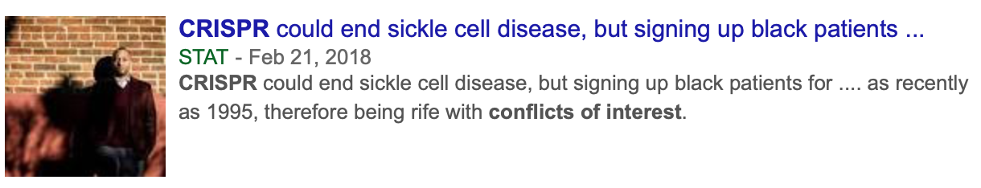
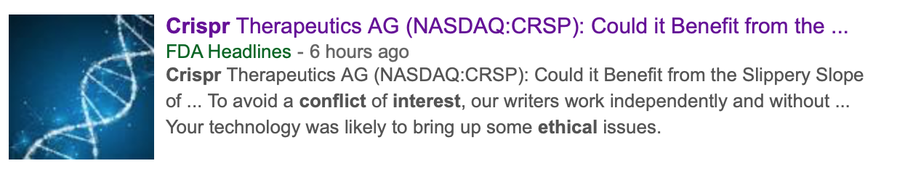
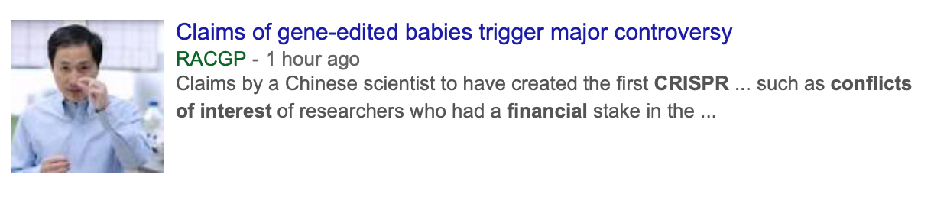
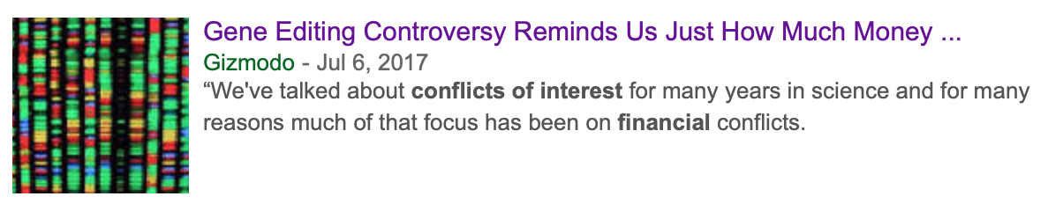
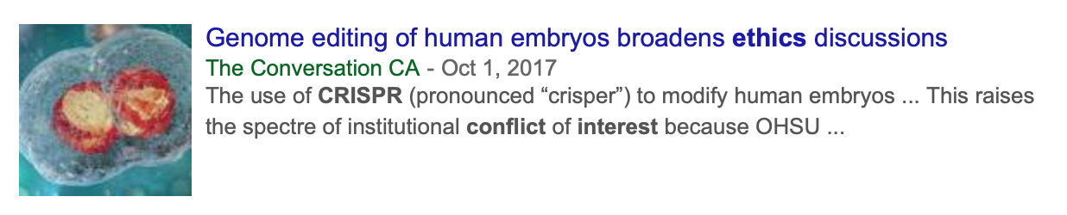
Gene editing and Conflict of Interest

Slide 13
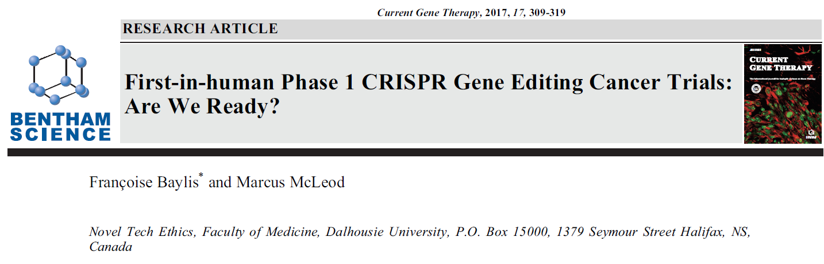
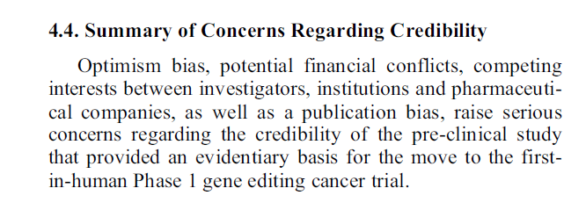
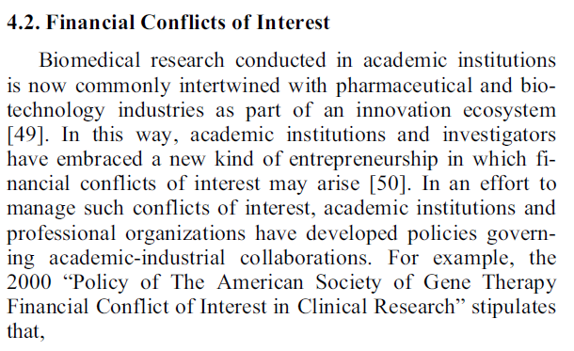

Slide 14
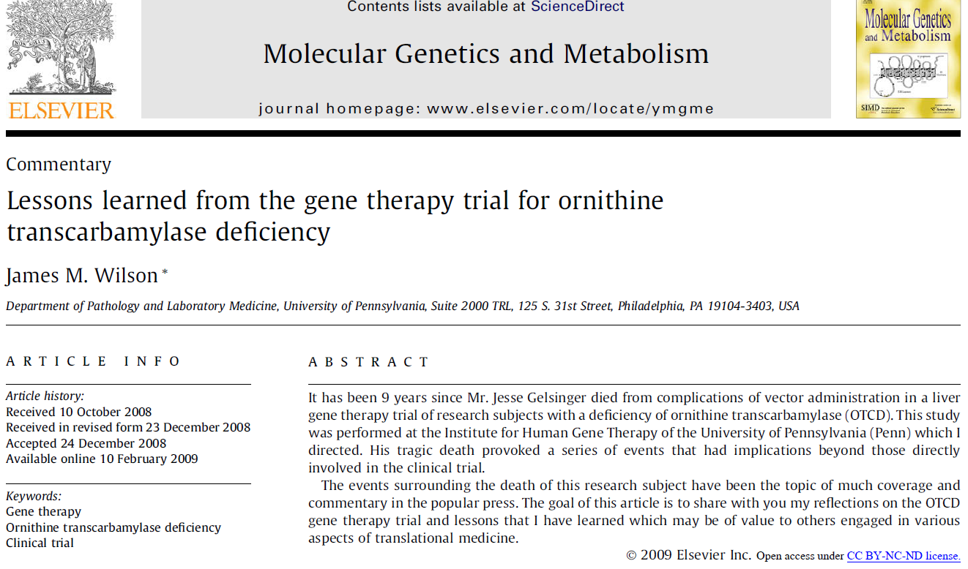
Notes:
A recent study to apply genetic editing to clinical practice raised the issue of COI, and also when an 18-year-old Jesse Gelsinger, who entered the University of Pennsylvania gene therapy, died during the study. James Wilson, then director of research at the time, says that looking back a decade later, it was hard for him to recognize the conflict of interest himself.

Slide 15
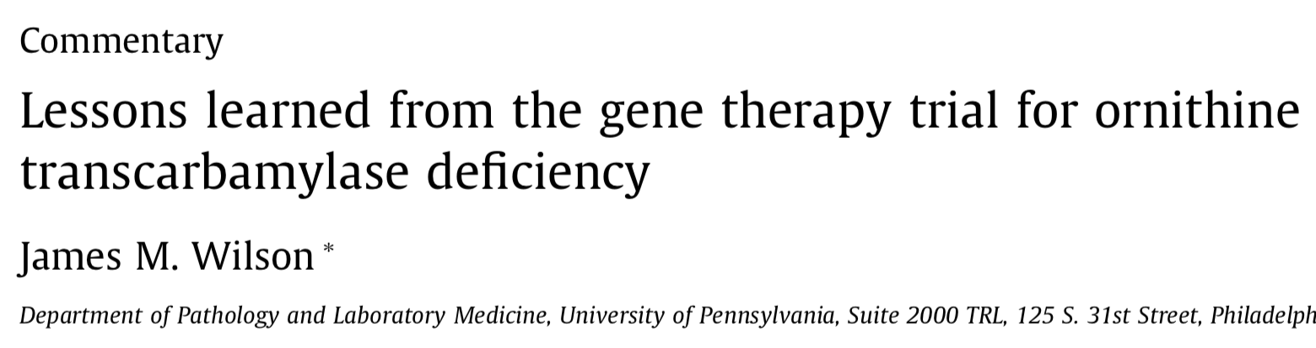
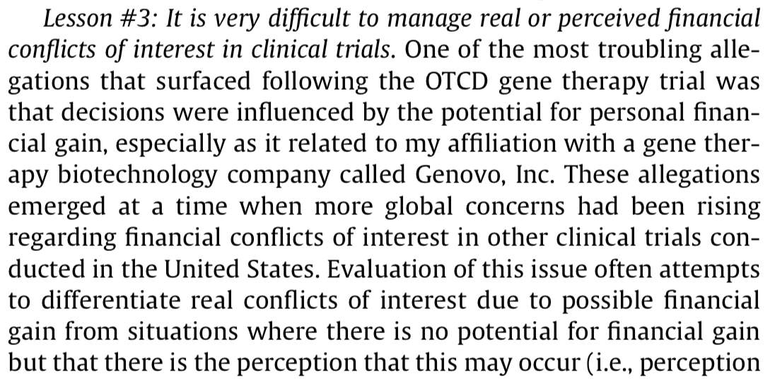
Lesson Learned

Slide 16
Bias Blindspot and Conflict of Interest
The problem of conflict of interest is difficult to judge for oneself because human being has a "bias blindspot.“
One cannot perceive that a bias occurs because of one's own interests.
In the Bible, Jesus said this well.
Why can you see so well the mote in your brother's eye while cannot see the beam in your own eye?
"And why beholdest thou the mote that is in thy brother's eye, but considerest not the beam that is in thine own eye?" (Matthew 7: 3)

Slide 17
Let us be vulnerable to open scrutiny
If there is a problem of local interstate that may erode universal responsibilities, whether it be researchers, research institutes or national units, you should make others or other actors judge of your own rather than by you.
To do this, you should be able to do self-doubt, be overseen and scrutinized, open to criticism by others or independent beings, with the idea that you may go wrong due to local interest.

Slide 18
Conclusion
Now, we are laying the foundation of the new norms for international and professional communities around Human Genome Editing.
So far, Conflict of Interest has been largely neglected and overlooked in process of making such norms.
Constant self-reflection and self-doubt on Conflict of Interest by informed individuals and institutions, will be the foundation of enhancing transparency, due care, responsible science, and fairness for the technology.

Slide 19
Reference
National Academies of Sciences, Engineering, and Medicine. (2017). Human genome editing: Science, ethics, and governance. National Academies Press.
Nuffield Council on Bioethics. (2018). Genome editing and human reproduction: social and ethical issues. Nuffield Council on Bioethics.
Sankar, P. L., & Cho, M. K. (2015). Engineering values into genetic engineering: A proposed analytic framework for scientific social responsibility. The American Journal of Bioethics, 15(12), 18-24.
Wilson, J. M. (2009). Lessons learned from the gene therapy trial for ornithine transcarbamylase deficiency. Molecular genetics and metabolism, 96(4), 151-157.

Slide 20
Acknowledgement
I thank Junho Jung, Ph.D. Candidate at Department of the History of Medicine and Medical Humanities College of Medicine Seoul National University for his help for this presentation

